Slide 1
Somatic Simu
Mutational signature simulator for benchmarking alignment-free
machine learning classification of genomic signatures

Slide 2
Introduction
Mutation Signatures: overview
Somatic mutations in cancer genomes can have an exogenous and endogenous origin
Characteristic mutations lead to a signature
Signatures have unique identifying features that differ relative to other signatures
Figure 1. Catalogue of Mutations in Cancer Genomes
Source: https://software.broadinstitute.org/cancer/cga/msp

Slide 3
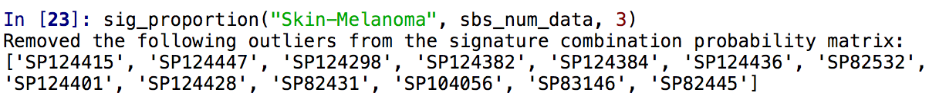
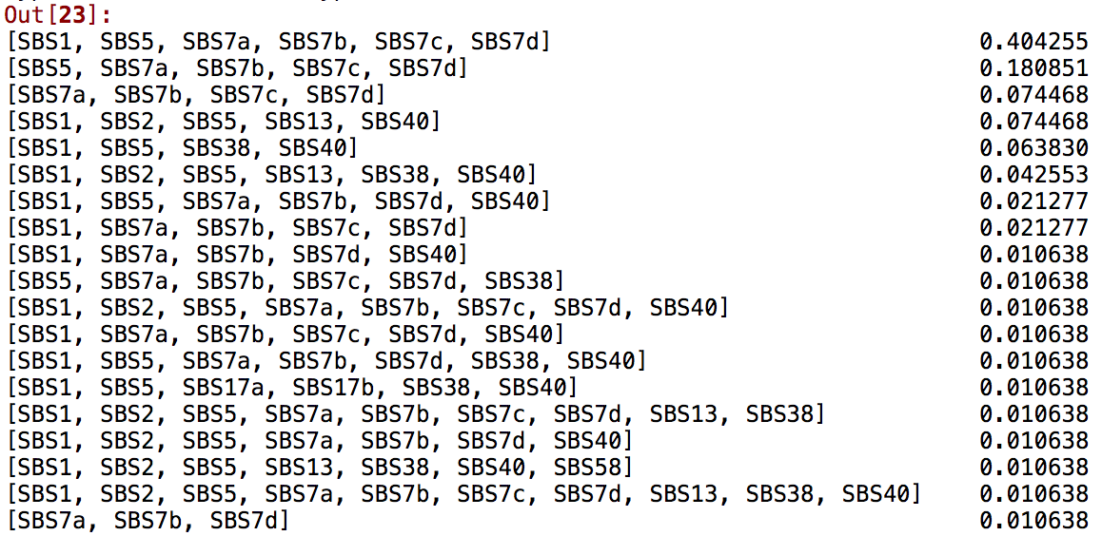
Introduction
Features of mutation signatures
Multiple mutational processes lead to superimposed signatures
Mathematical models estimate which mutations are attributed to which signature
Potential for classification
Figure 2: Set of single base substitution signatures and their relative proportion that contribute to Skin-Melanoma whole genome sequences in the PCAWG dataset

Slide 4
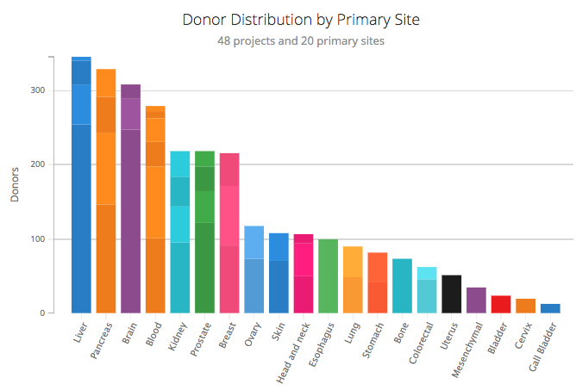
Literature
Current Literature
Previous studies have identified over 30 single base substitution signatures
Previous signature analyses predominantly used cancer exome sequences
PCAWG study identified and extracted relevant single base, double base, insertion and deletion mutation signatures from cancer whole genomes
Figure 3. PCAWG Whole Cancer Genome Donor Source
Source: https://dcc.icgc.org/pcawg

Slide 5
Literature
Pcawg dataset features
SigProfiler quantifies mutational signatures into mutational catalogues:
2,780 whole cancer genomes
79,793,266 single base substitutions
814,191 doublet base substitutions
4,122,233 small insertions and deletions
Source: https://www.nature.com/articles/s41586-020-1943-3

Slide 6
Literature
Evaluation of sigprofiler
Mathematical artifact or biologically plausible characterization
Requires human guided sensitivity
High accuracy score indicates that SigProfiler identification of mutation signatures accurately represents the profile of cancer whole genome sequence
Table 1: Statistics for SigProfiler Accuracy Score
Accuracy Score Statistic | Value
Mean | 96.2%
Median | 96.9%
Minimum | 65.9%
Maximum | 100%

Slide 7
Literature
Single Base substitution classification (SBS-96)
C>G
A
C>T
A
96
SBS
Types
C
C>A
C
G
T>A
G
T
T>C
T
T>G
Resource: https://cancer.sanger.ac.uk/cosmic/signatures/SBS

Slide 8
Literature
Double Base substitution classification (DBS-78)
10 Source Doublet Bases
Doublet Base Mutation
AT
TA
4 Self Reverse
Complement
6 Doublet Bases
CG
GC
78
SBS
Types
AC
TC
CC
TG
9 Doublet Bases
6 Strand-Agnostic
Doublets
CT
TT
Resource: https://cancer.sanger.ac.uk/cosmic/signatures/DBS

Slide 9
Literature
Reverse Complement (RC) Explained
Reverse Complement (6 type)
No Reverse Complement (9 type)
DBS | Mutation | RC Mutation
AT>NN | AT>CA | AT>TG
 | AT>CC | AT>GG
 | AT>CG | AT>CG
 | AT>GA | AT>TC
 | AT>GC | AT>GC
 | AT>GG
 | AT>TA | AT>TA
 | AT>TC
 | AT>TG
DBS | Mutation | RC Mutation
AC>NN | AC>CA | GT>TG
 | AC>CG | GT>CG
 | AC>CT | GT>AG
 | AC>GA | GT>TC
 | AC>GG | GT>CC
 | AC>GT | GT>AC
 | AC>TA | GT>TA
 | AC>TG | GT>CA
 | AC>TT | GT>AA
Resource: https://cancer.sanger.ac.uk/cosmic/signatures/DBS

Slide 10
Literature
Insertion and deletion classification (INDEL-24)
12 Insertion Contexts
12 Deletion Contexts
C
T
C
T
CC
TT
CC
TT
CCC
TTT
Single Base Insertion: +C
Single Base Insertion: +T
Single Base Deletion: -C
Single Base Deletion: -C
CCC
TTT
CCCC
TTTT
CCCC
TTTT
CCCCC
TTTTT
CCCCC+
TTTTT+
CCCCCC+
TTTTTT+
Resource: https://cancer.sanger.ac.uk/cosmic/signatures/ID

Slide 11
Somatic SiMu
Research proposal
Genomic signatures have proven to be useful as methods for taxonomic classification
Alignment-free machine learning approaches can classify at the species level
Source: https://www.nature.com/articles/s41598-018-38157-3
Source: https://bmcgenomics.biomedcentral.com/articles/10.1186/s12864-019-5571-y
To what degree of accuracy and sensitivity can alignment-free machine learning approaches classify cancer whole genomic signatures?

Slide 12
Somatic SiMu
Use Case
Generated simulated cancer sequences as fasta files based on biologically representative frequencies of SBS, DBS and indels
Benchmark the alignment-free machine learning approach for sensitivity between different cancer types
Benchmark alignment-free machine learning approaches for accuracy across successive iterations of mutation signature simulation on the same sequence

Slide 13
Methods
PCAWG Dataset 1: Signature Decomposition
SigProfiler identifies SBS, DBS and indel mutations in whole cancer genome sequences and attributes each to a unique mutational signature
Unique sets of SBS
Signatures present:
SBS1, SBS2, SBS3, SBS5
SBS1, SBS2, SBS5
SBS1, SBS3, SBS5
SBS1, SBS3, SBS5
SBS1, SBS2
Table 2: SigProfiler SBS signatures in Bone-Osteosarcoma samples
Accession ID | Accuracy | SBS1 | SBS2 | SBS3 | SBS4 | SBS5
SP116499 | 0.955 | 248 | 155 | 2217 | 0 | 571
SP116505 | 0.949 | 283 | 85 | 0 | 0 | 679
SP116509 | 0.986 | 132 | 0 | 2608 | 0 | 1243
SP116437 | 0.956 | 179 | 39 | 0 | 0 | 440
SP116512 | 0.919 | 199 | 0 | 2810 | 0 | 32

Slide 14
Methods
PCAWG Dataset 2: Mutation attribution
SigProfiler characterizes the probability that any given mutation attributed to a signature is a specific Type and SubType
Table 3: SigProfiler 96-type SBS Signatures
Type | SubType | SBS1 | SBS2 | SBS3 | SBS4 | SBS5
C>A | ACA | 8.86E-04 | 5.80E-07 | 2.08E-02 | 4.22E-02 | 1.20E-02
C>A | ACC | 2.28E-03 | 1.48E-04 | 1.65E-02 | 3.33E-02 | 9.44E-03
C>A | ACG | 1.77E-04 | 5.23E-05 | 1.75E-03 | 1.56E-02 | 1.85E-03
C>A | ACT | 1.28E-03 | 9.78E-05 | 1.22E-02 | 2.95E-02 | 6.61E-03

Slide 15
Methods
Somatic simu data pipeline
SBS Signature Total Frequency
SBS Signatures Probability
Accession ID | Accuracy | SBS1
SP116499 | 0.955 | 248
Type | Subtype | SBS1
C>A | ACA | 8.86E-04
C>A | ACC | 2.28E-03
C>A | ACG | 1.77E-04
C>A | ACT | 1.28E-03
Multiplied by
Frequency of 96-type SBS mutations attributed to SBS Signature 1 for the whole genome sequence of SP116499
Type | Subtype | Frequency
C>A | ACA | 0.219
C>A | ACC | 0.565
C>A | ACG | 0.0439
C>A | ACT | 0.317

Slide 16
Methods
Somatic simu data pipeline
Frequency of 96-type SBS mutations attributed to SBS Signature 1 for the whole genome sequence
Frequency of Subtype in the GRCh38.13 (Chr. 1-22, X and Y)
Type | Subtype | Frequency
C>A | ACA | 0.219
C>A | ACC | 0.565
C>A | ACG | 0.0439
C>A | ACT | 0.317
Subtype | Subtype Frequency in Reference Genome
ACA | ﻿34810647
ACC | ﻿41083452
ACG | ﻿32320384
ACT | ﻿39141433
Divided by
Probability of any given 96-type to undergo mutation in input sequence
Type | Subtype | Mutation Frequency
C>A | ACA | ﻿6.29117867e-9
C>A | ACC | 1.37524958e-8
C>A | ACG | 1.35827594e-9
C>A | ACT | ﻿8.09883481e-9

Slide 17
Methods
Somatic simu data pipeline
Probability of any given 96-type to undergo mutation in input sequence
G A C A C A T A C T
Sample Sequence:
Type | Subtype | Mutation Frequency
C>A | ACA | ﻿6.29117867e-9
Mutation occurs
P = ﻿6.29117867e-9
No mutation
P = 0.9999999937
A A A
A C A

Slide 18
Methods
Somatic simu data pipeline
Mutation probabilities calculated based on:
2780 whole cancer genomes
37 cancer types
4 Signature types: SBS-96, DBS-78, Single Base Insertion and Deletion-24

Slide 19
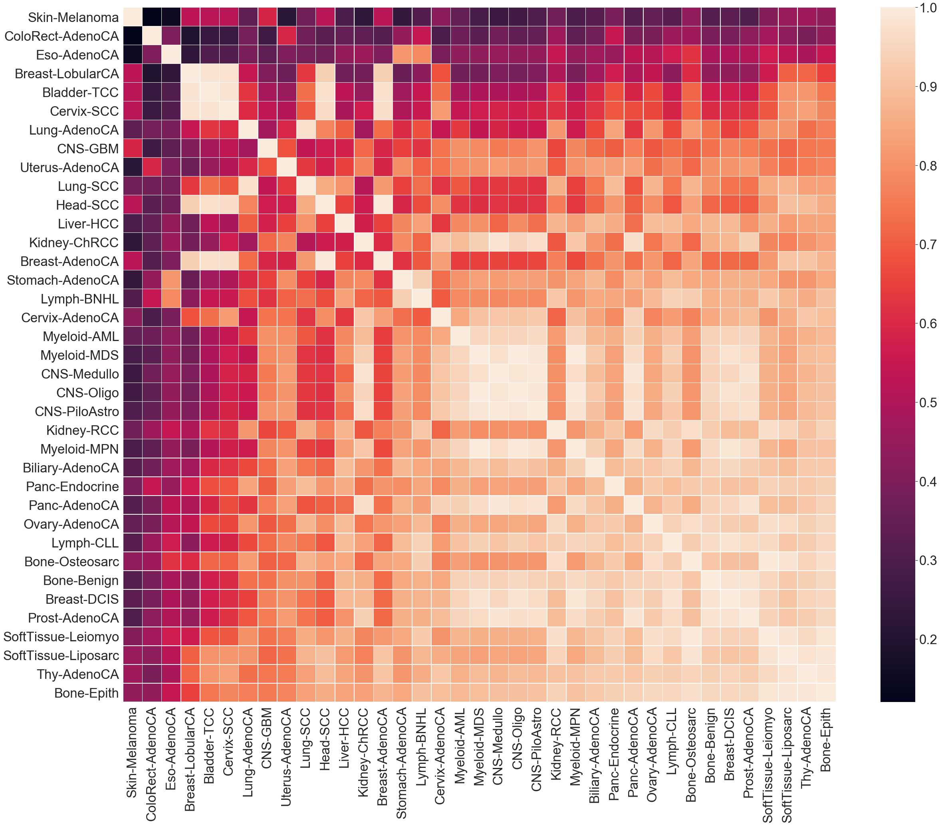
Methods
Cosine Similarity of SBS Mutation Probabilities
Cosine similarity is metric used to compare the similarity of a multidimensional metric
Higher score indicates higher similarity between cancer types and more similar evolutionary trajectories

Slide 20
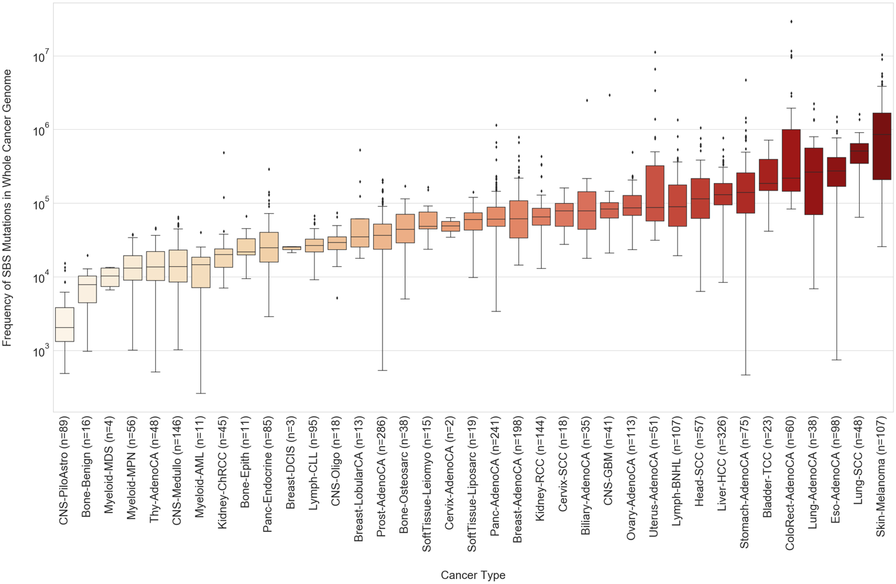
Methods
SBS Mutation Burden in whole genome

Slide 21
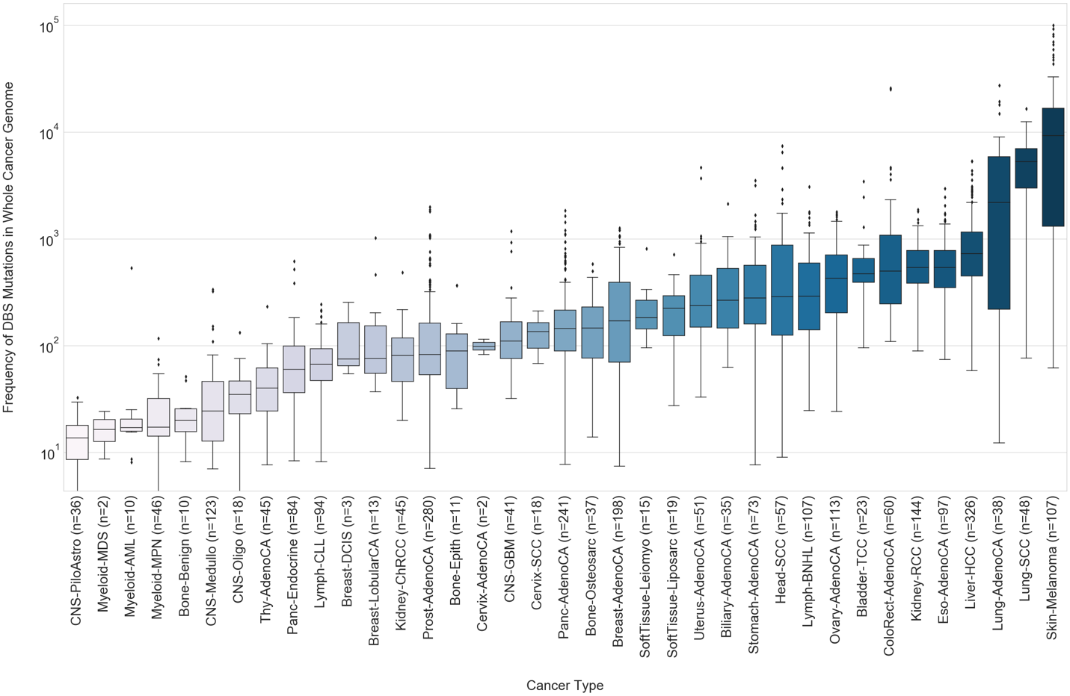
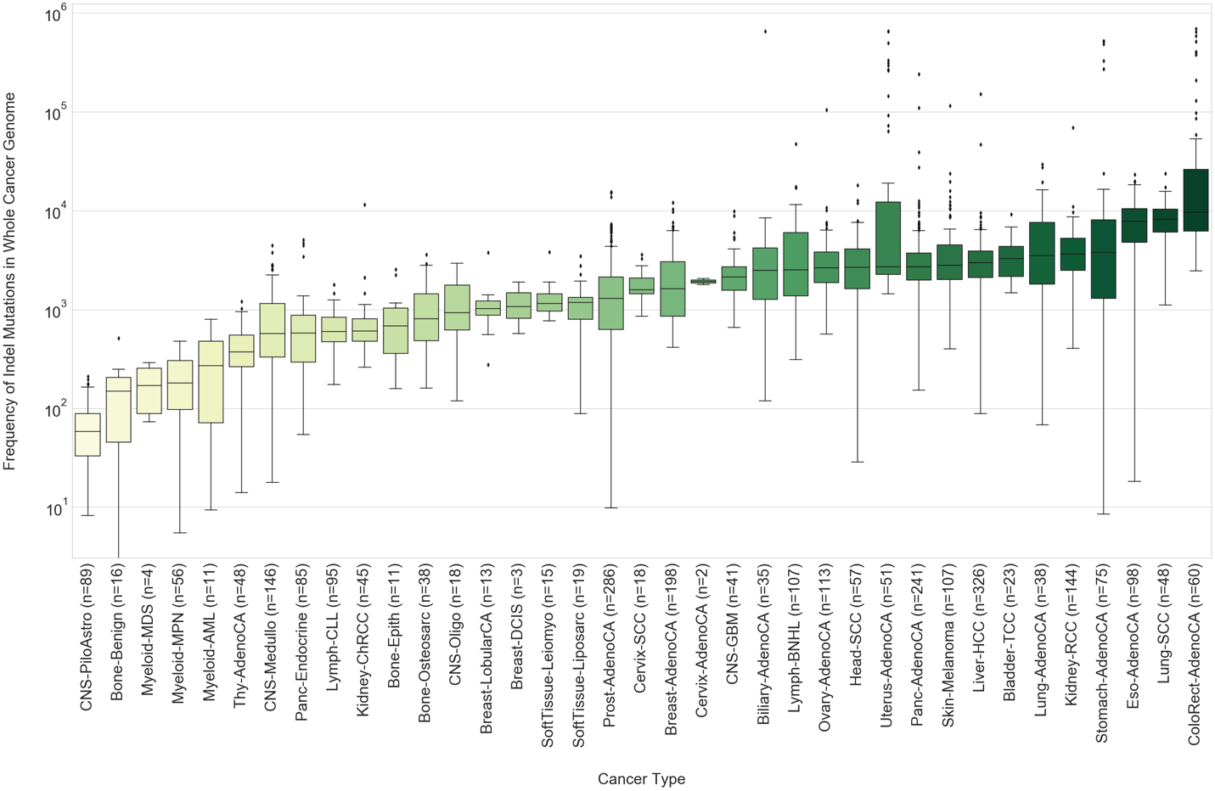
Methods
DBS and Indel Mutation Burden in whole genome

Slide 22
Features
Parallel Directed evolution simulation
Iteration 1
Iteration 2
Iteration 3
Cancer
Type Signatures

Slide 23
Features
Outlier removal
Somatic SiMu can remove hyper-mutated sequences at a specified parameter of standard deviation (default = 3 STD)
Table 4: Subset of Skin-Melanoma Mutation Frequency attributed to SBS7a Signature
Accession ID | SBS7a Signature Mutation Frequency
SP124444 | 12882
SP124365 | 51274
SP124420 | 52941
SP124364 | 75499
SP124307 | 93890
SP82445 | 577976
SP83242 | 41151

Slide 24
Features
Synonymous codons
Somatic SiMu can implement linear bias between synonymous vs. non-synonymous mutations
Syn_rate: Proportion of synonymous mutations applied (default: 1.00)
Non_syn_rate: Proportion of non-synonymous mutations (default: 1.00)
DBS mutations can affect adjacent codons
Figure 4. Synonymous codons of 20 amino acids
Source: https://www.researchgate.net/figure/Synonymous-Codons
-of-20-Amino-Acids_fig2_324469014

Slide 25
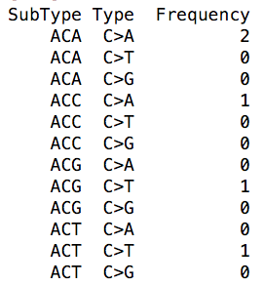
Features
Mutation frequency Table
Outputs a 4 csv files of all mutations applied in one iteration:
SBS-96 Mutations
DBS-78 Mutations
Insertion-12 Mutations
Deletion-12 Mutations
Figure 5. SBS Mutation Frequency Table

Slide 26
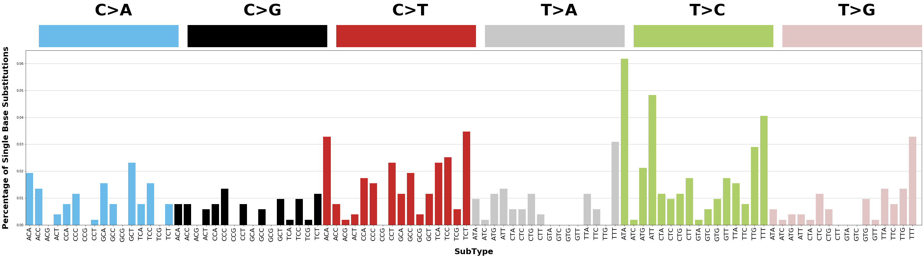
Features
Proof of concept
SBS Mutation Profile after 10 Generations of Simulation on Chromosome 22
Source: https://cancer.sanger.ac.uk/cosmic/signatures/

Slide 27
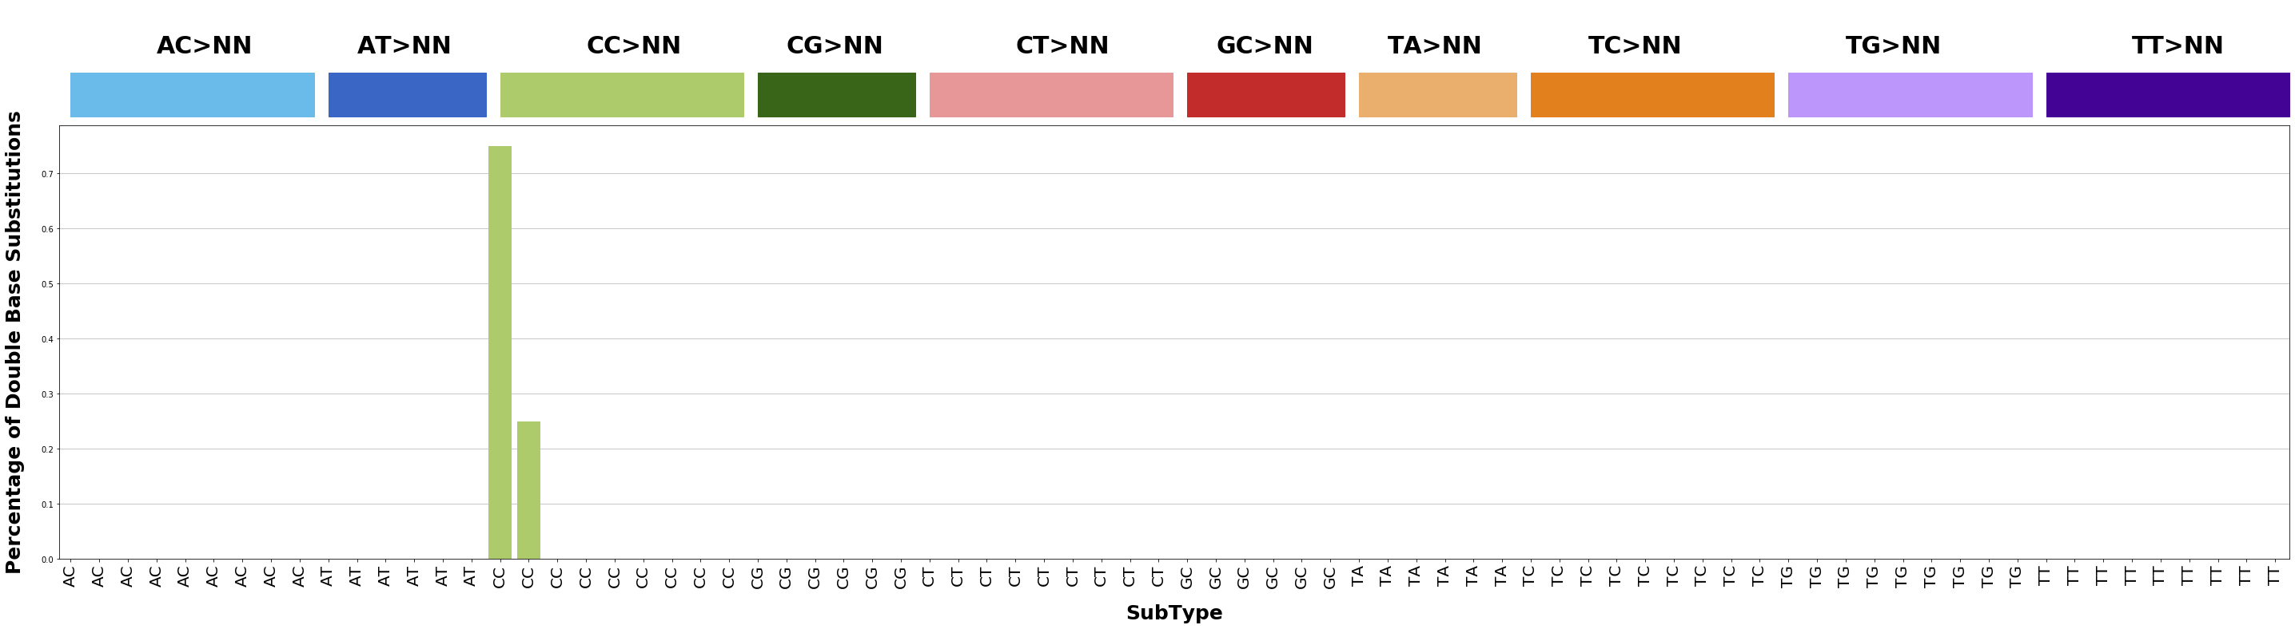
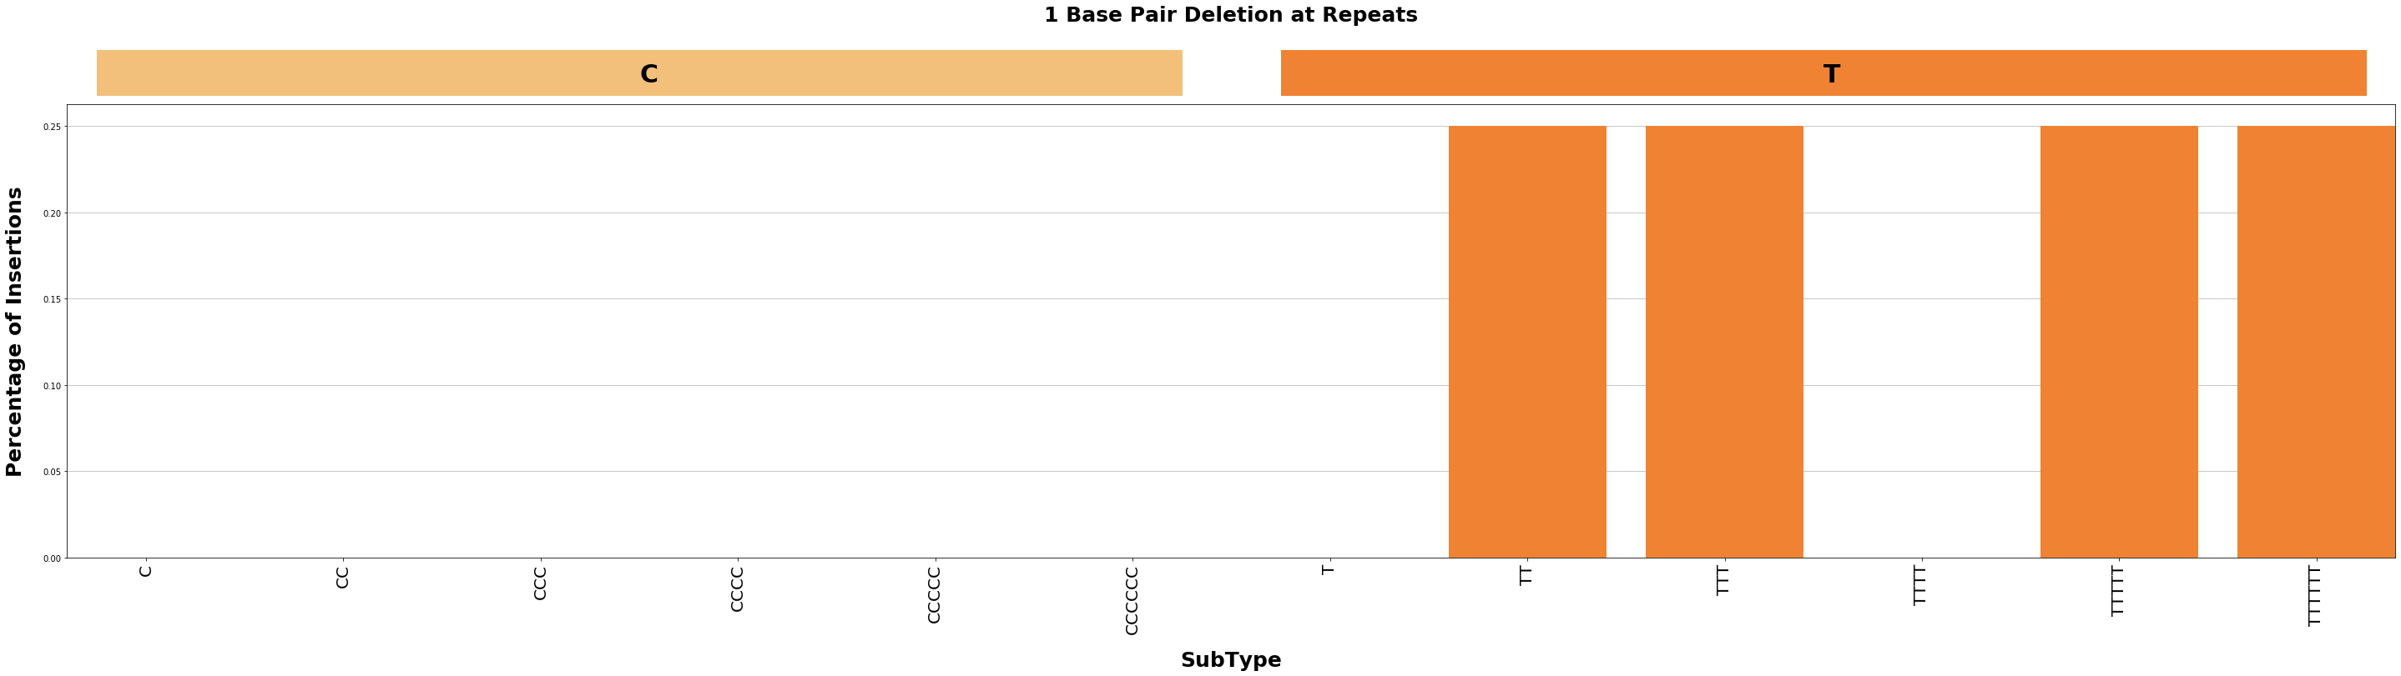
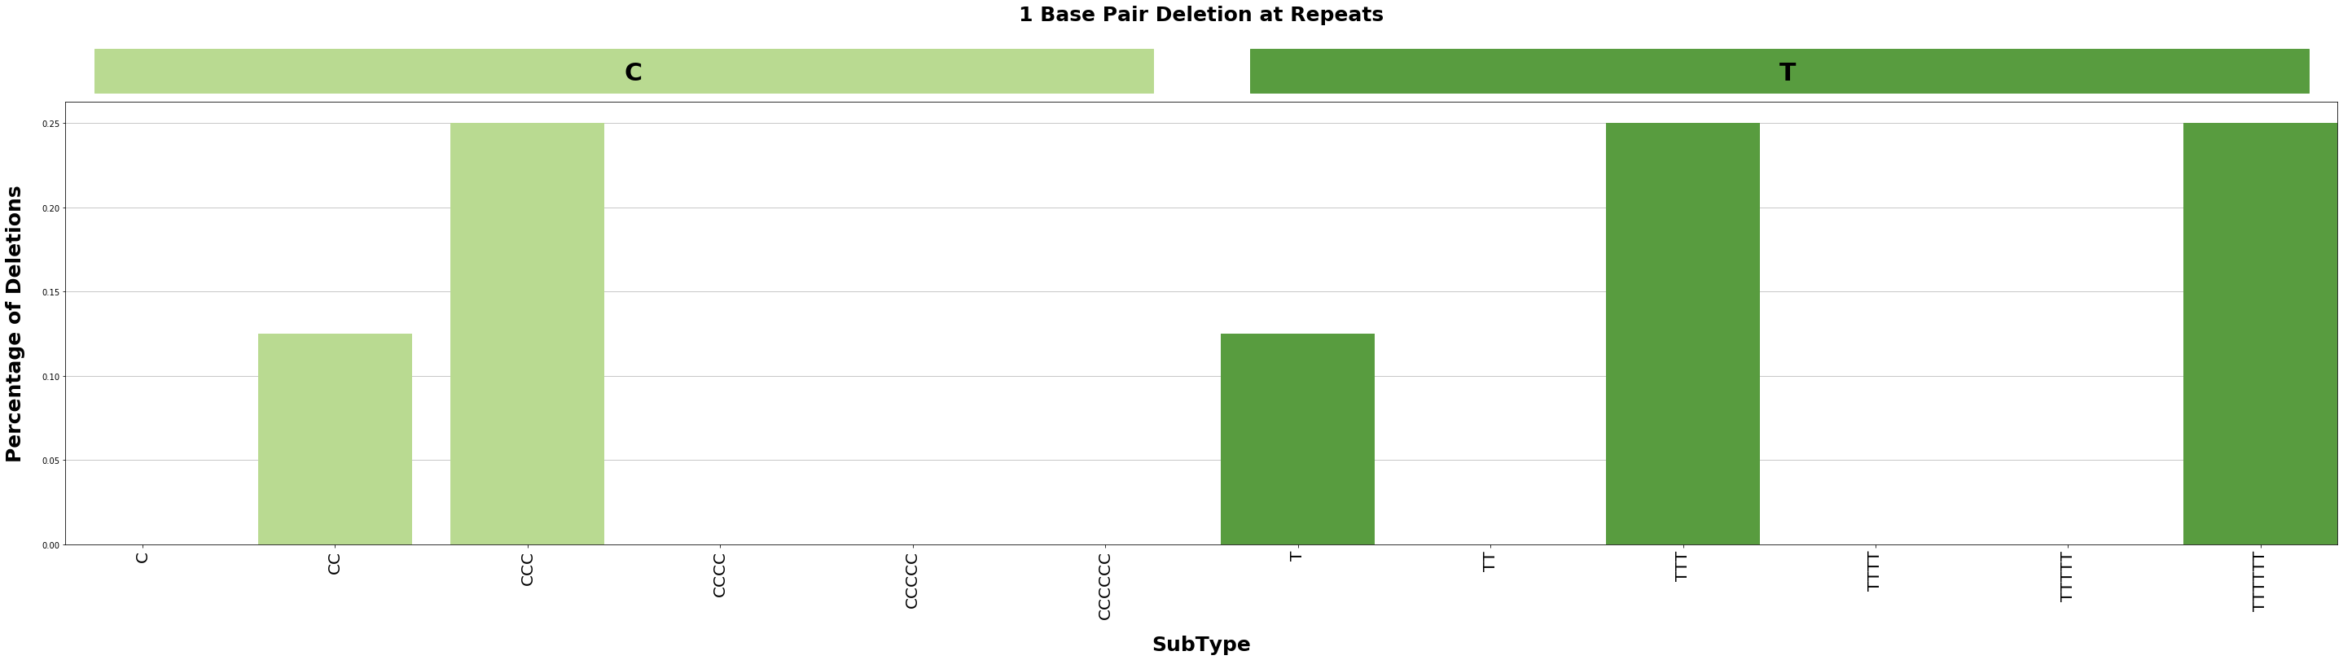
Features
Proof of concept
DBS and Indel Mutation Profile after 10 Generations of Simulation on Chromosome 22
DBS
Insertion and Deletion

Slide 28
Features
Next steps
Biologically relevant contexts and accurate simulation (temporal: episodic and spatial: kataegis)
Generate datasets for MLDSP classification (ongoing)
Considerations of NMF: Extraction of sparse and meaningful features from a set of high dimensional, non negative data vectors conversely loses reference contexts

